Slide 1



The 7 Habits for Managers
GÖRKEM KAYA - 211015002
TOTAL QUALITY MANAGEMENT

Slide 2
How will the presentation flow?
TOTAL QUALITY MANAGEMENT

Slide 3
Presentation Schedule
Information on how the presentation will proceed.
01.
02.
03.
04.
Event 01
Event 02
Event 03
Event 04
Let’s get to know author
The 7 habits for managers
Basic solutions to major management problems
Conclusion
TOTAL QUALITY MANAGEMENT

Slide 4

First Part: 7 Habits of Manager
Be Proactive
Start with the end in mind
Put First Things First
Think Win-Win
Seek First to Understand
Then to Be Understood
Synergize
Sharpen the Saw
Table of Contents
TOTAL QUALITY MANAGEMENT

Slide 5
Second Part: Basic solutions to major management problems
How can I make effective decisions?
How can I be successful when my resources are limited?
How do I manage time effectively?
How do I conduct a difficult conversation effectively?
How do I manage meetings effectively?
How do I conduct an effective performance evaluation?
How do I reward people appropriately?
Table of Contents
TOTAL QUALITY MANAGEMENT

Slide 6

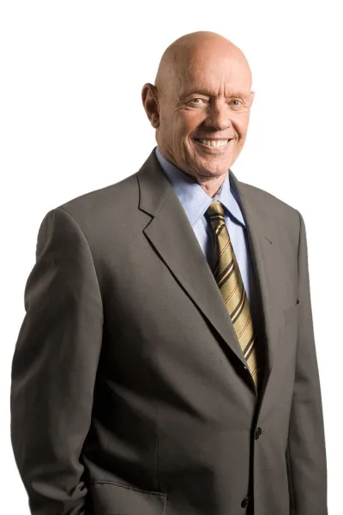

Stephen R. Covey
Stephen Richards Covey was a significant author who left a mark in the modern world of personal development and leadership. He was born in 1932 in the state of Utah, USA, and worked for many years as an educator and consultant. He reached a wide audience with his ideas on leadership, effective communication, and personal success.
www.reallygreatsite.com

Slide 7
Presentation Schedule
Information on how the presentation will proceed.
01.
02.
03.
04.
Event 01
Event 02
Event 03
Event 04
Let’s get to know author
The 7 habits for managers
Basic solutions to major management problems
Conclusion
TOTAL QUALITY MANAGEMENT

Slide 8
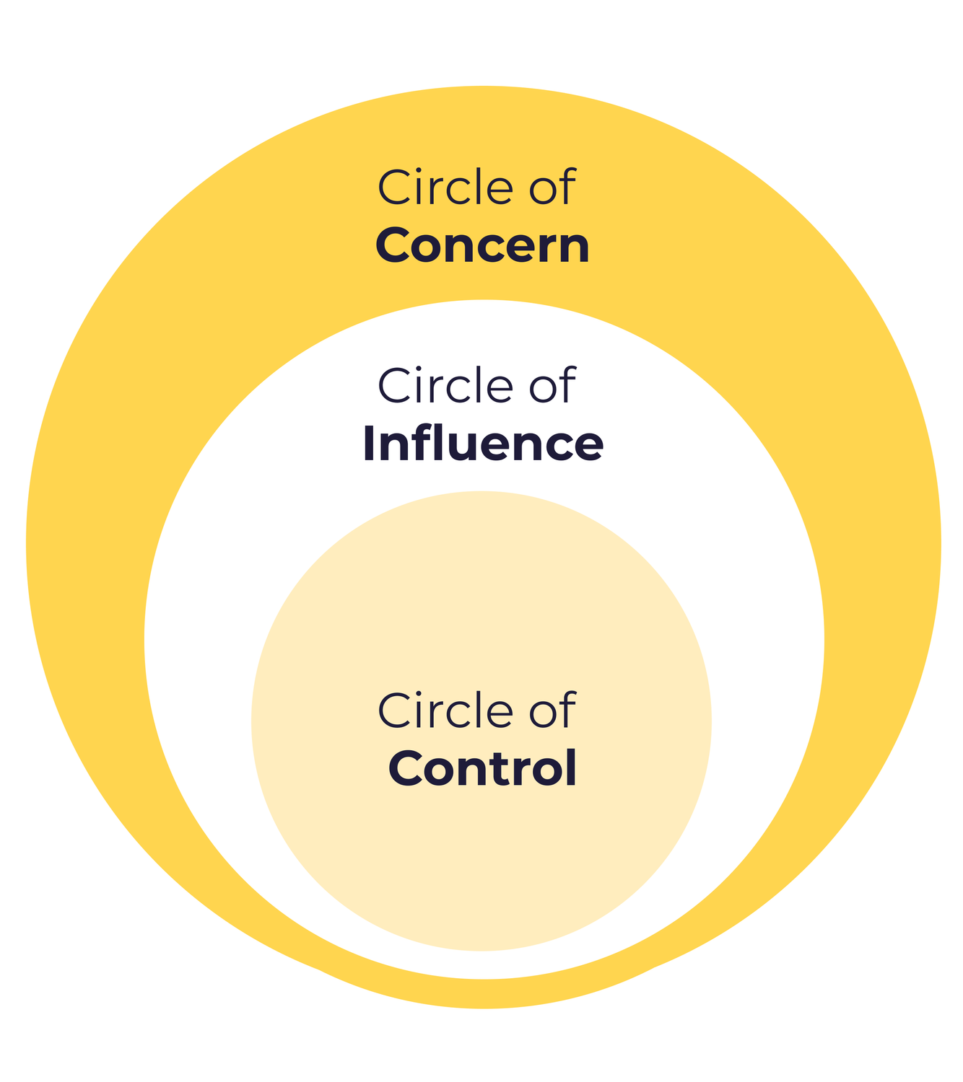
1.Habit : Be Proactive
See the Alternatives, not the Obstacles.
While mediocre managers only see obstacles, effective managers use their skill and initiative to overcome them.
Focus on things you can change
Effective managers focus their efforts on things they can change ("Circle of Influence") and do not worry about things they can do nothing about ("Circle of Concern")
TOTAL QUALITY MANAGEMENT

Slide 9

2.Habit : Start with the end in mind
Describe how you will be useful.
Bad managers live day to day, thinking of nothing but ‘getting the job done.’ Effective managers are very clear about the job to be done. They know what contribution they, and no one else, can make.
TOTAL QUALITY MANAGEMENT

Slide 10
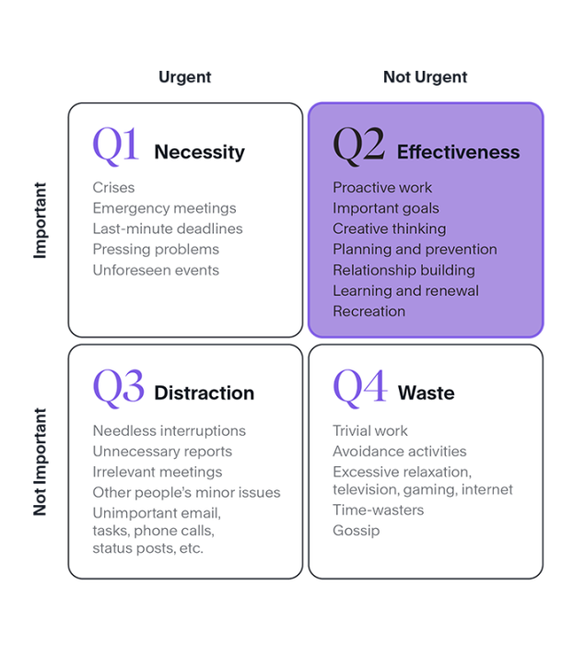
3.Habit : Put First Things First
Focus on what is important, not just what is urgent
Effective managers always work in the 2nd zone of the time matrix. Planning, preparation and taking precautions are essential here. In this way, they minimize the work in the 1st zone, which means crisis management, and the 3rd and 4th zones, which are not critical at all.
Plan weekly, work daily
If we work according to the plans, the usage of the first region will decrease significantly because everything is going as planned.
TOTAL QUALITY MANAGEMENT

Slide 11
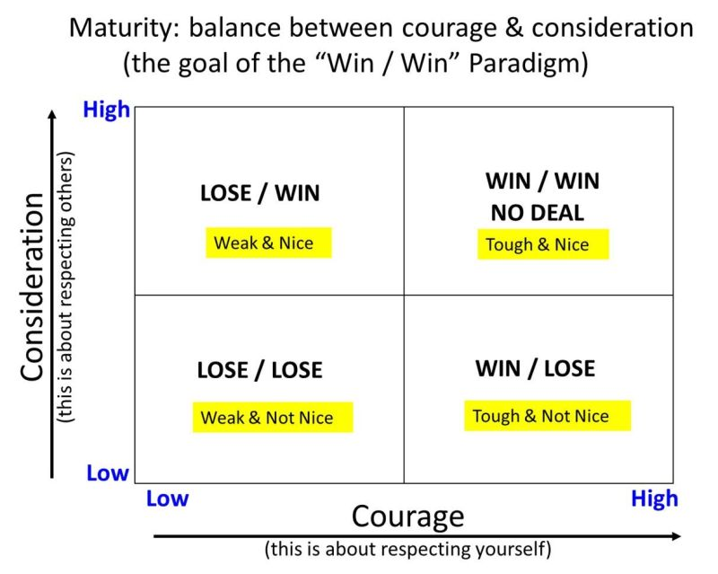
4.Habit : Think Win-Win
Balance courage and caution
Win-win managers are both courage and coution. They motivate their teams to perform to perfection. Managers who do not think in a win-win way will eventually lose.
Build emotional connection, build trust
Build and invest in a bond with each team member.
TOTAL QUALITY MANAGEMENT

Slide 12
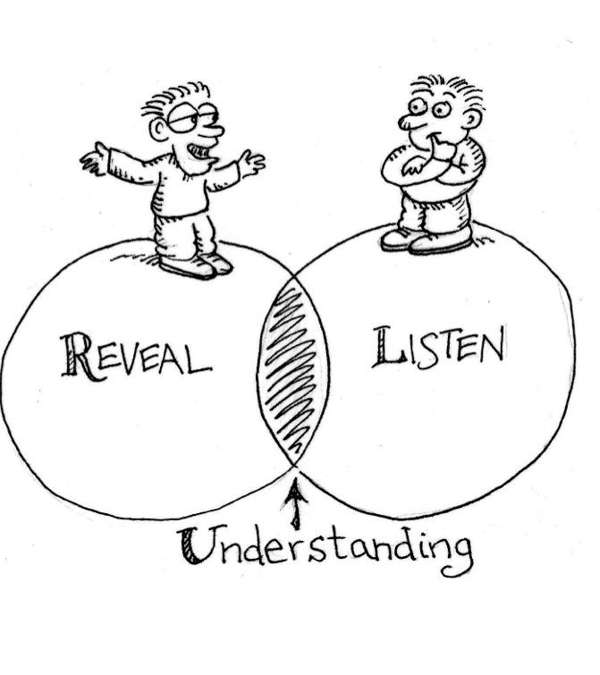
5.Habit : Seek first to understand then to be understood
Practice Empathic Listening
Effective managers know how to listen empathetically. In other words, they seek to understand the needs, concerns, and priorities of their team members, bosses, and coworkers.
Give accurate and honest Feedback
Effective managers give cautious but courageous feedback.
Don't Use Comparative Language
-- You have to do it the way Howard did it.
Practice Empathic Listening
"I guess you feel like..."
TOTAL QUALITY MANAGEMENT

Slide 13
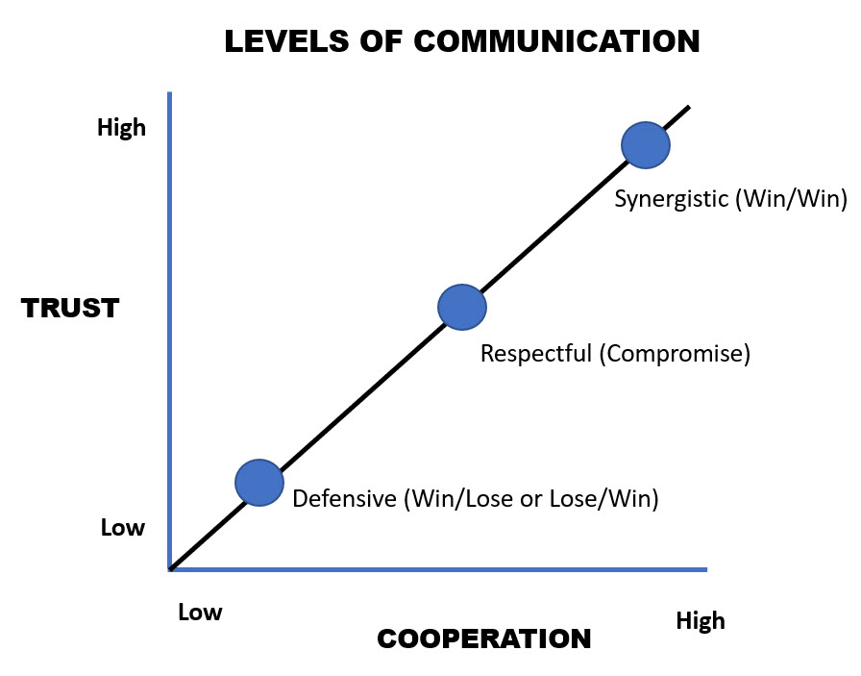
6.Habit : Synergize
Don't just accept change, seek it.
Effective managers intentionally seek out ideas that differ from their own because they know that good ideas come from robust dialogue and discussion, not from “group think.”
Create synergy to reach New and Better alternatives
Effective teams are always looking for new and better ways. First, they define their success criteria. Then they create prototypes. Then they persistently evaluate completely different ideas. Ideally, they arrive at a solution that combines the best of everyone's thinking, the 'third alternative.'
TOTAL QUALITY MANAGEMENT

Slide 14
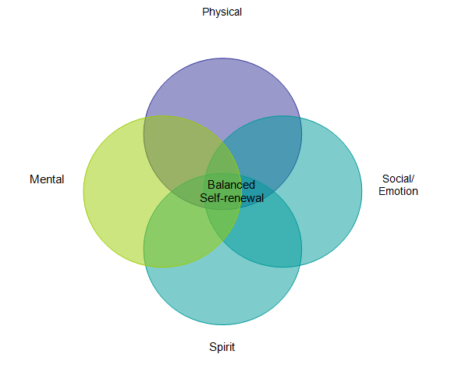
7.Habit : Sharpen the saw
Treat team members as individuals
Effective managers make it a habit to treat all team members as individuals.
They provide team members with:
Each of them should work in a way that they find spiritually meaningful.
Each one of them should work in the most suitable physical conditions and their personal rights should be distributed fairly.
TOTAL QUALITY MANAGEMENT

Slide 15
Presentation Schedule
Information on how the presentation will proceed.
01.
02.
03.
04.
Event 01
Event 02
Event 03
Event 04
Let’s get to know author
The 7 habits for managers
Basic solutions to major management problems
Conclusion
TOTAL QUALITY MANAGEMENT

Slide 16
Second Part: Basic solutions to major management problems
1
How can I make effective decisions?
1
The key to effective decision making is to create synergy (Habit 6, Synergize). Synergy is created when people come together and come up with a solution that is better than any one of them could come up with.
TOTAL QUALITY MANAGEMENT
1
2
3
4
5
6
7

Slide 17
Second Part: Basic solutions to major management problems
2
How can I be successful when my resources are limited?
2
Managers are often asked to "do more with less." When you're asked to achieve results with limited resources, think big (Habit 1, Be Proactive)
1
2
3
Question 1
Question 2
Question 3
Who do I know who can help?
Who has done it before? How did they do it?
Who has a different perspective?
TOTAL QUALITY MANAGEMENT
1
2
3
4
5
6
7

Slide 18
Second Part: Basic solutions to major management problems
3
How do I manage time effectively?
3
In order to use time more effectively, the 3rd Habit(Put First Things First), which is about effective use of time, can be used.
1
2
Advice 1
Advice 2
Carefully select a few 'top priority' goals to achieve
Plan your week, work daily.
TOTAL QUALITY MANAGEMENT
1
2
3
4
5
6
7

Slide 19
Second Part: Basic solutions to major management problems
4
How do I conduct a difficult conversation effectively?
4
Empathic Listening (Habit 5) is key to dealing with difficult conversations because it gives people a chance to express their feelings and air any issues openly in a non-threatening environment.
1
2
Advice 1
Advice 2
Repeat what he said, just in different sentences. This will show the other person that you understand him.
Listen to your interlocutor without interrupting
TOTAL QUALITY MANAGEMENT
1
2
3
4
5
6
7

Slide 20
Second Part: Basic solutions to major management problems
5
How do I manage meetings effectively?
5
You can use Habit 2(Start with the end in mind) to get the best results from the meetings you lead.
1
2
Advice 1
Advice 2
Begin with the end in mind. Define from the outset what the purpose of the meeting is.
At the end of the meeting, see if the meeting achieved its purpose.
TOTAL QUALITY MANAGEMENT
1
2
3
4
5
6
7

Slide 21
Second Part: Basic solutions to major management problems
6
How do I conduct an effective performance evaluation?
6
Use these reviews as opportunities to create win-win (4.Habit) performance agreements.
1
“How is going?”
“What are you learning?”
Advice 1
“What can I do for you?”
Help your employees. Guide them by asking questions.
TOTAL QUALITY MANAGEMENT
1
2
3
4
5
6
7

Slide 22
Second Part: Basic solutions to major management problems
7
How do I reward people appropriately?
7
Know your team well enough to know how to reward them. What one employee gets rewarded may not be seen as a reward by another.
1
Advice 1
Be careful to give natural rewards such as approval, appreciation, and promotion.
TOTAL QUALITY MANAGEMENT
1
2
3
4
5
6
7

Slide 23
Presentation Schedule
Information on how the presentation will proceed.
01.
02.
03.
04.
Event 01
Event 02
Event 03
Event 04
Let’s get to know author
The 7 habits for managers
Basic solutions to major management problems
Conclusion
TOTAL QUALITY MANAGEMENT

Slide 24


Conclusion
1. Did you like the book?
5. Give a score or rate this book
Yes I liked it, it was a good book
2. What did you learn from the book?
I learned how certain behaviors affect management and everyday life.
3. What was the part you were most impressed by?
I really liked the quote on page 76, "How I learned to Let My Workers Lead."
4. Would you recommend the book for reading?
Yes , I would recommend everyone for reading. They will be gain a lot of important information with this book.
TOTAL QUALITY MANAGEMENT

Slide 25
Presentation Schedule
Information on how the presentation will proceed.
01.
02.
03.
04.
Event 01
Event 02
Event 03
Event 04
Let’s get to know author
The 7 habits for managers
Basic solutions to major management problems
Conclusion
TOTAL QUALITY MANAGEMENT

Slide 26
Thank you for listening.
TOTAL QUALITY MANAGEMENT

